Slide 1
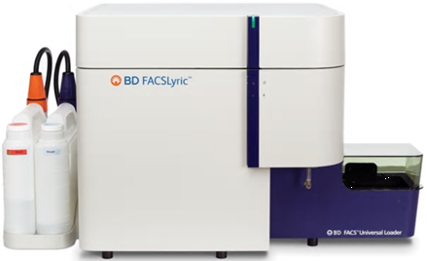
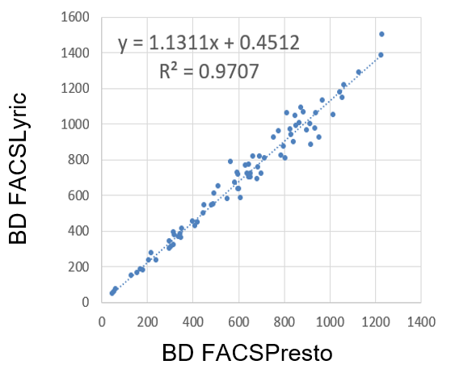
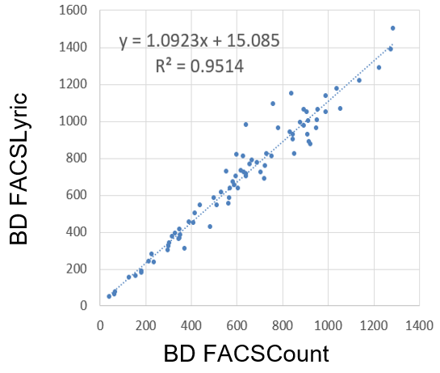
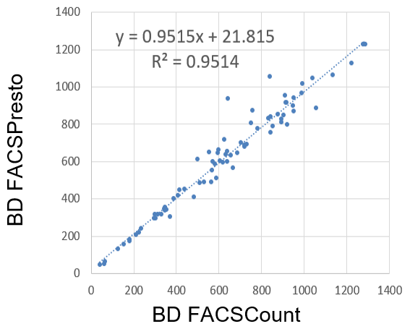
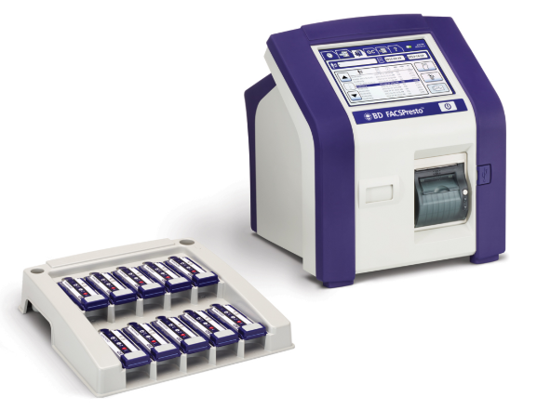
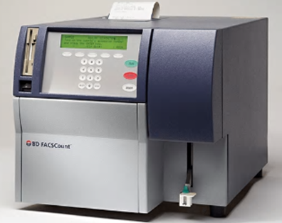
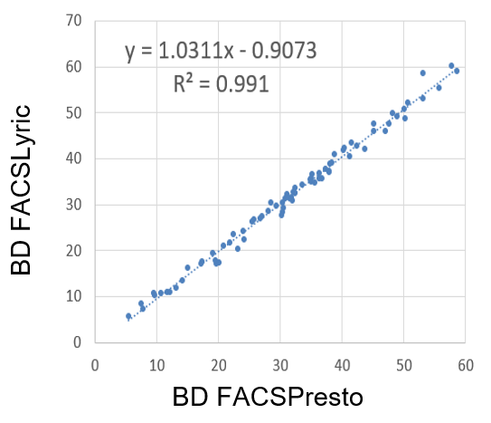
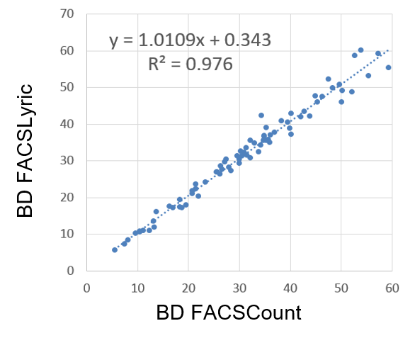
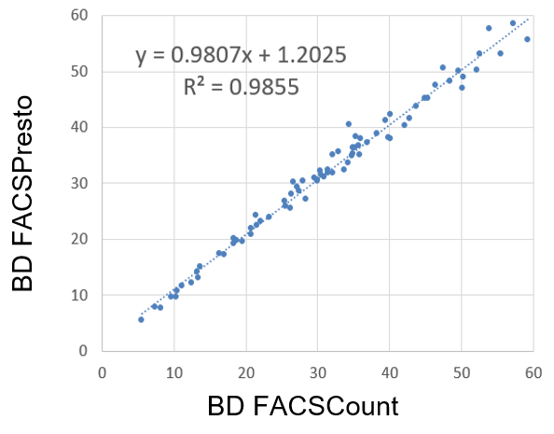
Poster#
PEB0101
Evaluation of CD4 T-cells on the BD FACSLyric™, BD FACSPresto™, and BD FACSCount™ Systems
A. Chen, H. Rohamare, F. Oreizy, Y. Zeng.
BD Life Sciences, San Jose, CA, United States.
Abstract
Results (1). Pair-Wise Comparisons of CD4 Absolute Counts on BD FACSLyric,
FACSCount and FACSPresto Systems:
CD3+CD4+ count remains one of the most important indicators in HIV/AIDS staging and patient management. BD developed a new clinical flow cytometer, the BD FACSLyricTM, featuring streamlined workflow and standardization to help maximize cross-lab compatibility and data quality. The BD FACSPrestoTM System is a portable CD4 counter. The BD FACSCountTM System has been used for CD4 counting worldwide for over a decade. In this study, we compare CD4 absolute count and CD4% on the BD FACSLyric, BD FACSPresto and BD FACSCount Systems. De-identified remnant HIV+ blood specimens (n = 77) were enrolled in the study. Each specimen was stained using the BD TritestTM CD3 FITC / CD4 PE / CD45 PerCP Reagent* in BD Trucount™ Tubes, the BD FACSPresto Cartridge (CD4 PE-Cy5 / CD3 APC / CD 45RA APC / CD14 PE), and the BD FACSCount Reagent (CD4 PE / CD3 PE-Cy5 and CD8 PE / CD3 PE-Cy5). The stained samples were simultaneously acquired on the three instruments. Results of CD4 count and CD4% were analyzed using linear regression. A two-by-two contingency table was used to assess agreement about CD4 cutoff at 200 cells/µL. Linear regression results are shown in Figures 1 and 2. On each of the three instruments, seven samples presented CD4 count below 200 cells/µL, while 70 samples were above. The BD FACSLyric, FACSPresto and FACSCount Systems are designed to meet the needs of CD4 testing in central laboratories with high sample throughput, small testing laboratories and applications that need portable CD4 counters. Using 77 remnant HIV+ samples, we demonstrated consistent results in CD4 T-cell absolute count and CD4% on three different instruments.
*The BD Tritest CD3/CD4/CD45 Reagent on the BD FACSLyric System is not available for sale in the USA.
1A
BD FACSseq Cell Sorting
Figure 1A.
Comparing CD4 Absolute Count (cells/μl) on BD FACSLyric vs. FACSPresto Systems:
Figure 1B.
Comparing CD4 Absolute Count (cells/μl) on BD FACSLyric vs. FACSCount Systems:
Figure 1C.
Comparing CD4 Absolute Count (cells/μl) on BD FACSPresto vs. FACSCount Systems:
BD FACSLyric™ Flow Cytometer
BD FACSPresto™ CD4 Counter
Linear regression results are shown in Figure 1 above comparing CD4 absolute counts. On each of the three instruments, seven samples presented CD4 count below 200 cells/µL, while 70 samples were above. In Figures 1A, 1B and 1C, we observe R² > 0.95 and agreement of results between respective pairs of instrument comparisons.
₊
Results (2). Pair-Wise Comparisons of Percent CD4 Outputs on BD FACSLyric,
FACSCount and FACSPresto Systems:
Methods
Relative Protein Expression of CD44 and Her2/Neu
Instruments
BD FACSCount System
BD FACSLyric Flow Cytometer
BD FACSPresto Portable CD4 Counter
Sample Staining and Acquisition
HIV+ blood (age of blood <24hr) were stored at 20-25˚C and processed as follows:
BD FACSCount System
HIV+ blood was stained with BD FACSCount Reagent Kit CD4/CD8/CD3 (Cat. No. 340167) and acquired on the BD FACSCount System.
BD FACSLyric Flow Cytometer
HIV+ blood was stained with BD Tritest CD3/CD4/CD45 Reagent (Cat. No. 340383) and acquired on the BD FACSLyric Flow Cytometer.
BD FACSPresto CD4 Counter
HIV+ blood was stained with BD FACSPresto Cartridge (Cat. No. 657681) and read on the BD FACSPresto CD4 Counter.
Figure 2A.
Comparing % CD4 on BD FACSLyric vs. FACSPresto Systems:
Figure 2B.
Comparing % CD4 on BD FACSLyric vs. FACSCount Systems:
Figure 2C.
Comparing % CD4 on BD FACSPresto vs. FACSCount Systems:
BD FACSCount™ System
Conclusions
The BD FACSLyric™ and FACSCount™ Systems are designed to meet the needs of CD4 testing in core laboratories with high sample throughput and small to medium testing laboratories. BD FACSPresto™ System provides a portable CD4 testing solution in resource limited settings such as HIV clinics, except in the US.
Using 77 remnant HIV+ samples, we demonstrated consistent results in CD4 T-cell absolute count and CD4% on three different instruments.
Linear regression results are shown in Figure 2 above comparing percent CD4. R² values in each plot demonstrate goodness-of-fit for each linear regression. An R² value of 1 indicates a perfect fit. In Figures 2A, 2B and 2C, we observe R² > 0.97 and agreement of results between instruments in respective pair-wise comparisons.
Class 1 Laser Product. BD, the BD Logo, FACSCount, FACSLyric, FACSPresto, Tritest and Trucount are trademarks of Becton, Dickinson and Company or its affiliates. © 2020 BD. All rights reserved.
BD Life Sciences
2350 Qume Drive, San Jose, CA 95131
Visit bdbiosciences.com
23-22832-00
Notes:
™

